Slide 1


FIFA 19 analysis Soccer: Live it and love it
Marco Lin

Slide 2

agenda
Data explore
Correlation between different position and skills
Next champion prediction
Dream team

Slide 3
Introduction
Kaggle.com
18206 Soccer Players Data
Nationality, Wage, Value, Overall Score, Potential Score, Position, Score of different Position, Aggression, Reactions, ShortPassing etc.

Slide 4
Data Clean
Club, Club Logo, Photo, Flag, Loaned From, Real Face, Body Type, Contract Valid Until, Release Clause
Players who have N/A Value

Slide 5
Backgrounds

Slide 6
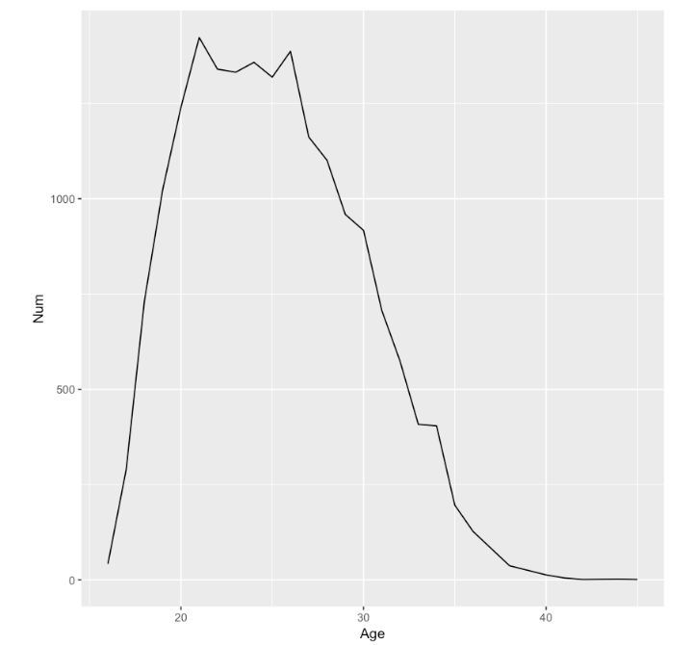
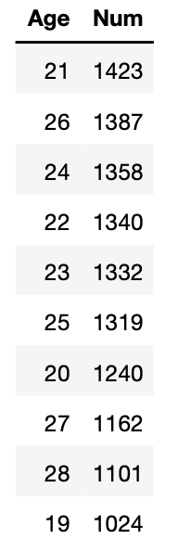
Player Age
20~26
Almost 10000 players

Slide 7
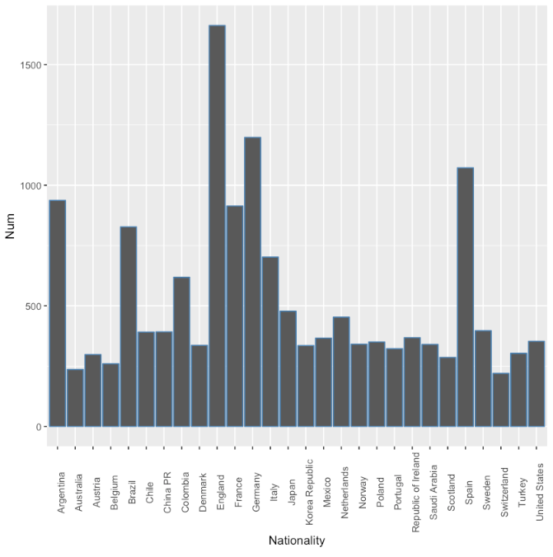
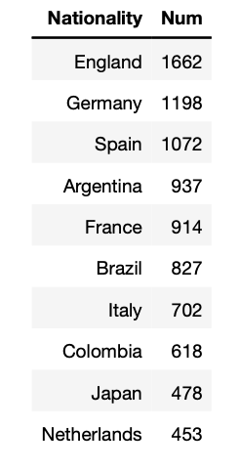
Nationality

Slide 8
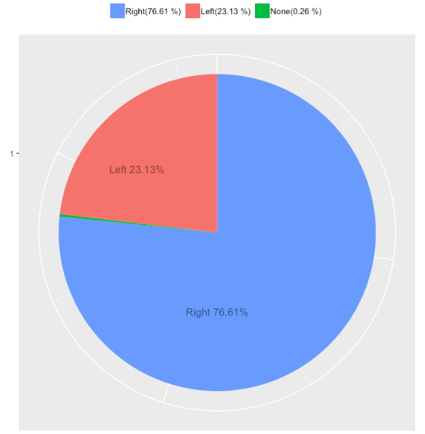
Preferred Foot
Left : 23.13%
Right : 76.61%

Slide 9
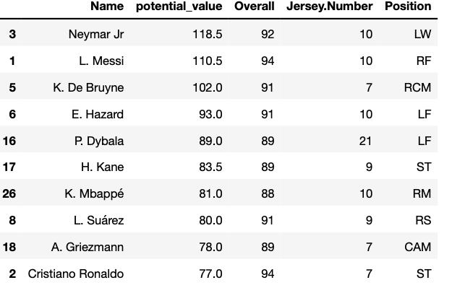
Value Player

Slide 10
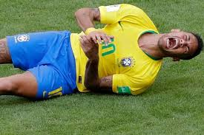
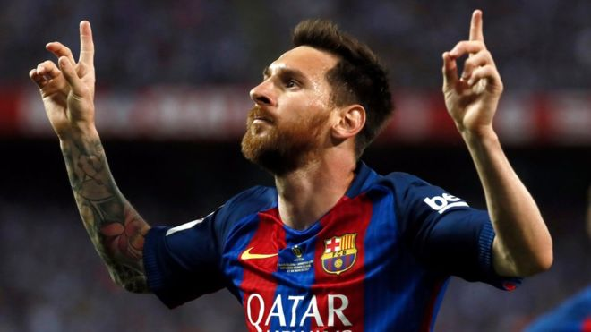
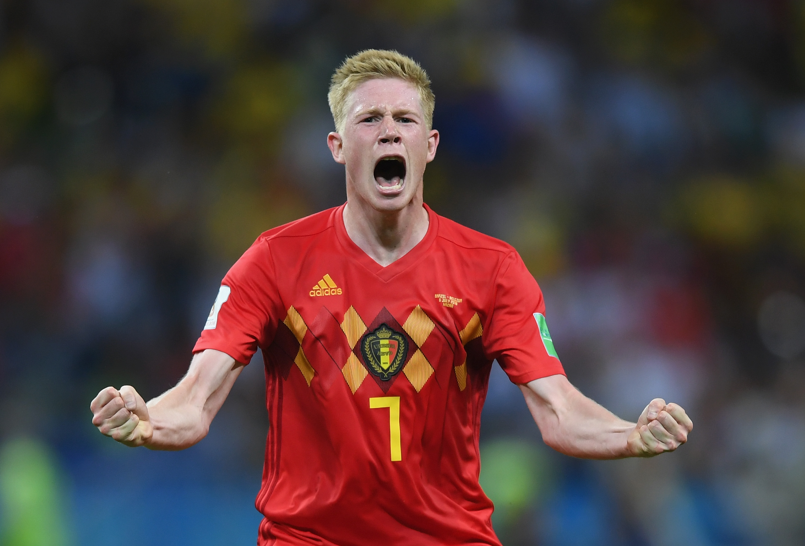
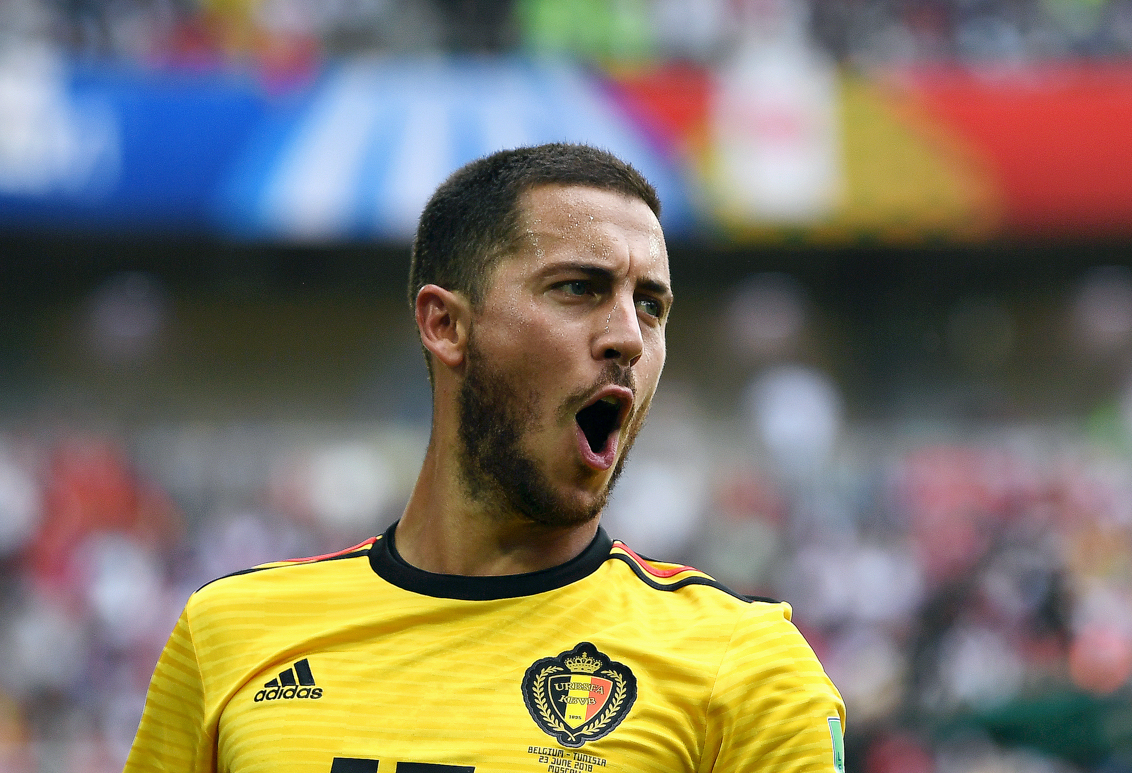
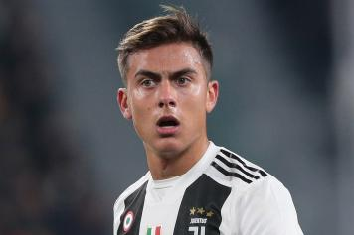

Slide 11
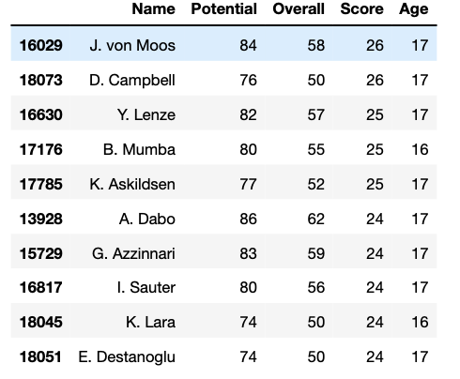
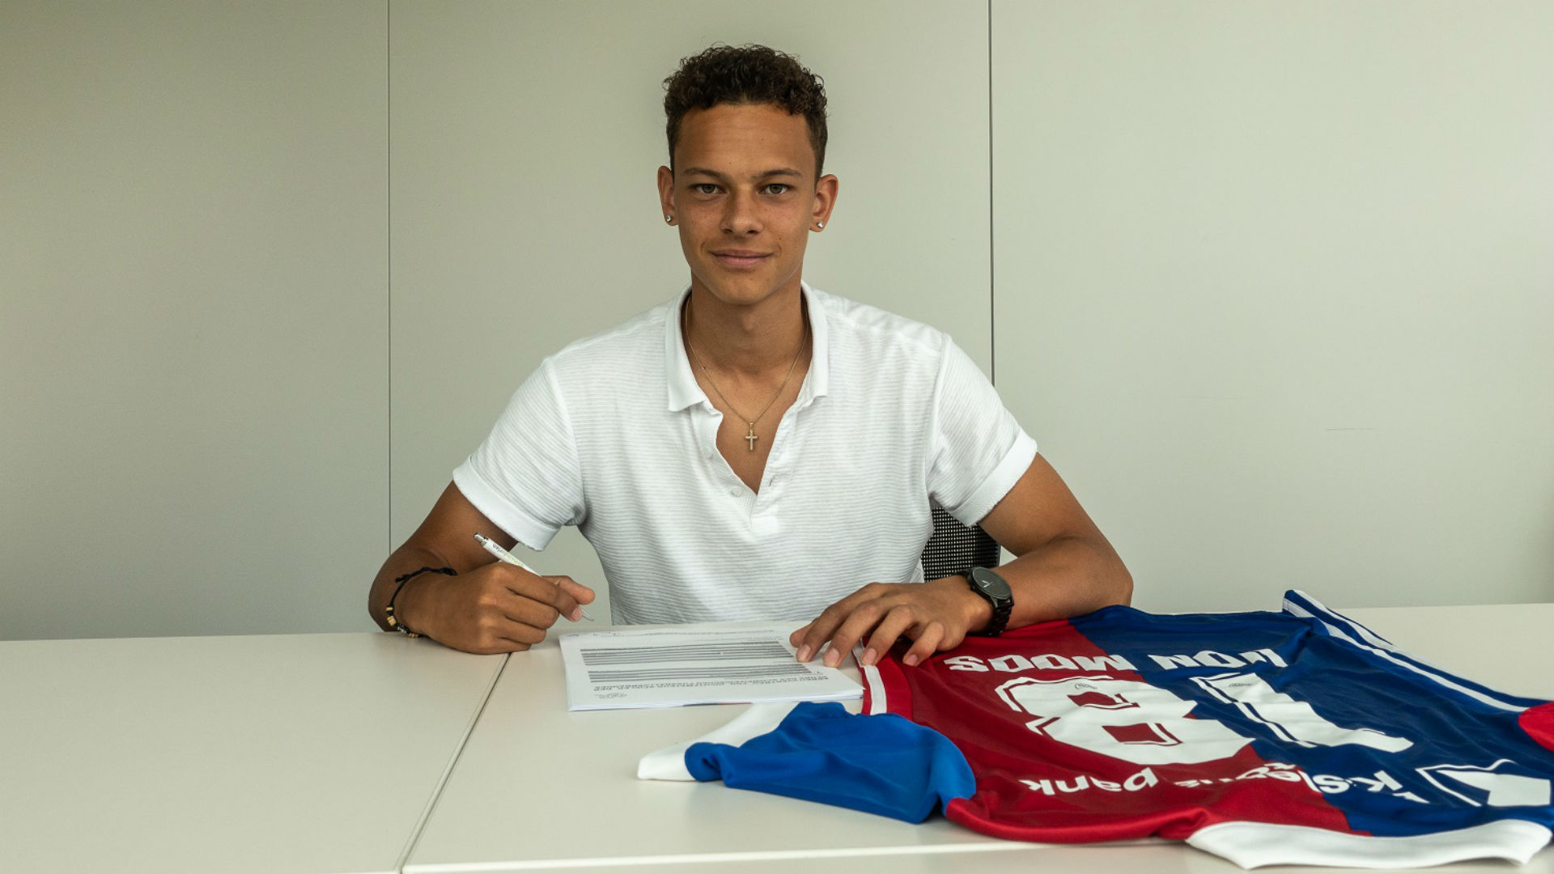
Adaptation
Potential Score – Overall Score = Score (potential growth Score)

Slide 12
Simple Linear Regression

Slide 13
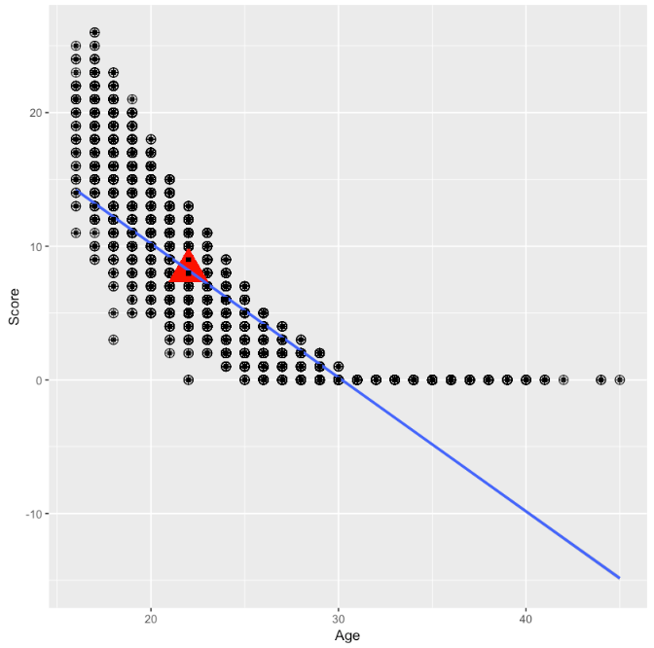
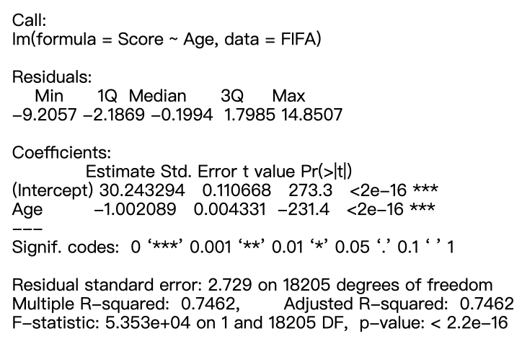
Potential growth ~ Age
Predict Age = 22
PS: Potential Score – Overall Score = Score

Slide 14
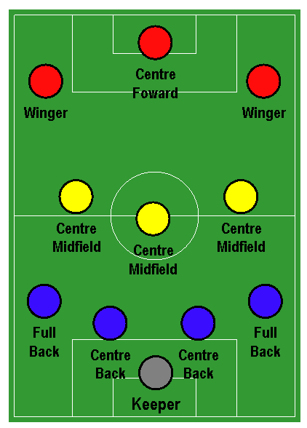
list of abbreviations
Defensive:
GK = Goalkeeper
SW = Sweeper
RWB = Right Wing Back
RB = Right back
RCB = Right center back
CB = Center back
LCB = Left center back
LB = Left back
LWB = Left Wing Back
Midfielders:
RDM = Right defensive midfield
RCDM = Right center defensive midfield
CDM = Center defensive midfield
LCDM = Left center defensive midfield
LDM = Left defensive midfield
RWM = Right Wing Midfield
RM = Right midfield
RCM = Right center midfield
CM = Center Midfield
LCM = Left center midfield
LM = Left midfield
LWM = Left Wing Midfield
RAM = Right attacking midfield
RCAM = Right center attacking midfield
CAM = Center attacking midfield
LCAM = Left center attacking midfield
LAM = Left attacking midfield
Forwards:
RF = Right forward
CF = Center forward
LF = Left forward
RS = Right Striker
ST = Striker
LS = Left Striker

Slide 15
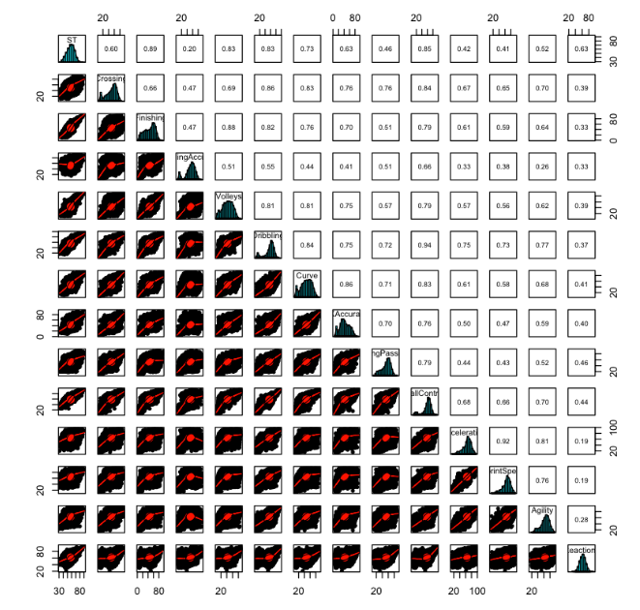
Strike position
Correlation with
Ball Control
Finishing
Dribbling

Slide 16
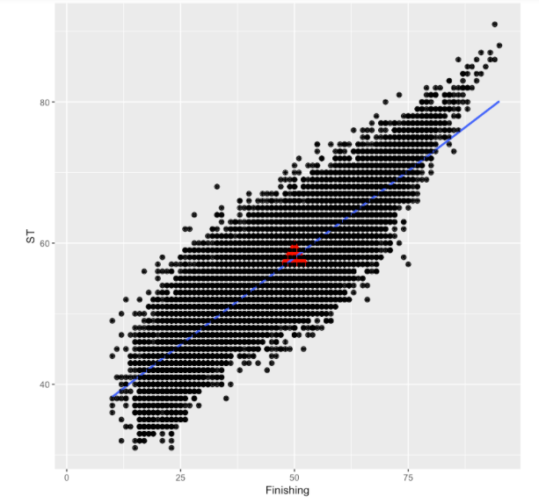
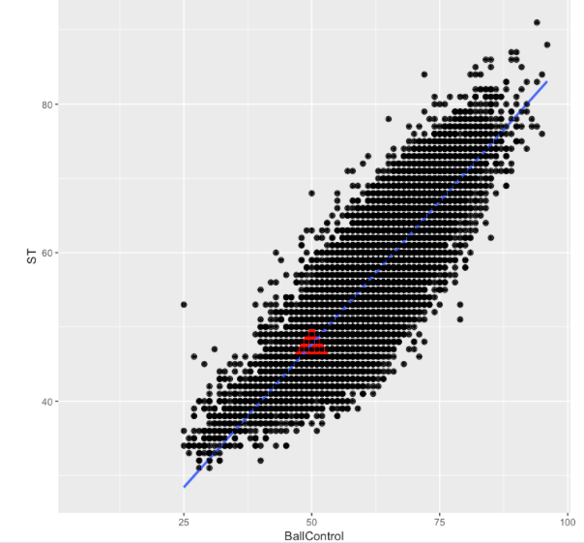
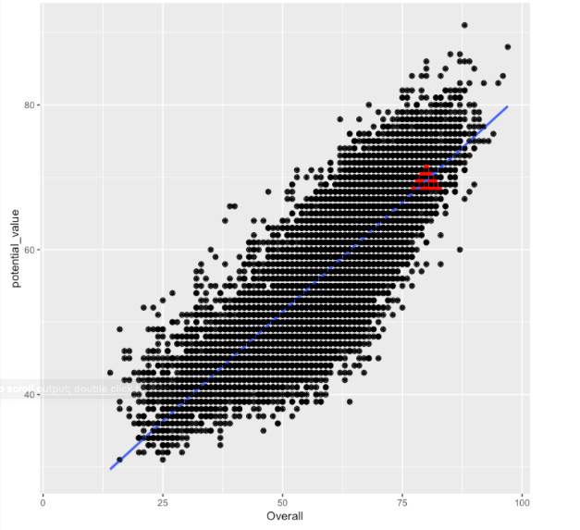
Strike position
Correlation with
Ball Control
Finishing
Dribbling

Slide 17
Multiple Linear Regression

Slide 18
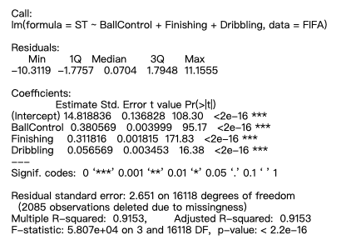
Strike position
Multiple Linear Regression
Correlation with
Ball Control
Finishing
Dribbling

Slide 19
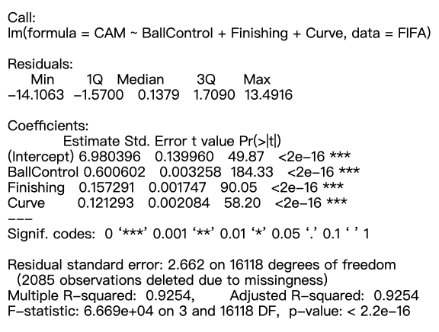
Central Attack midfield
Correlation with
Ball Control
Finishing
Curve

Slide 20
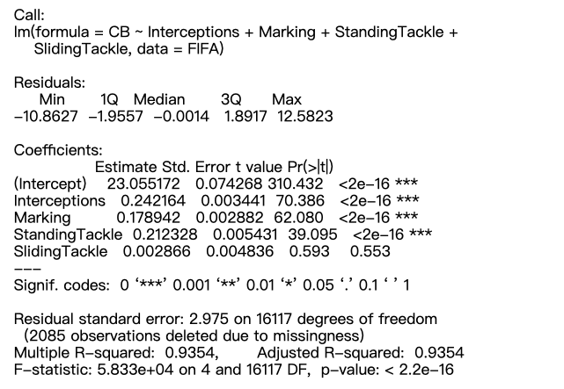
Central Back
Correlation with
interceptions
Marking
Standing Tackle
Sliding Tackle

Slide 21
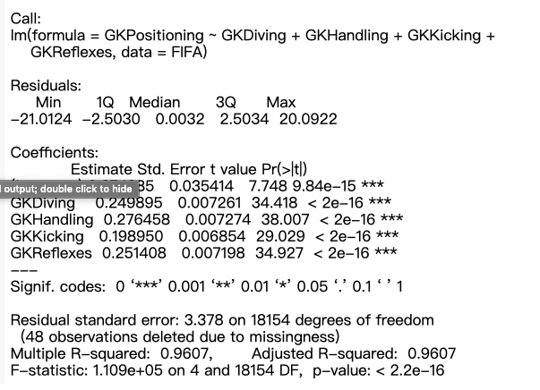
Goal Keeper
Correlation with
Diving
Handing
Kicking
Reflexes

Slide 22
Best Squared

Slide 23
4-3-3 formation
Defensive:
GK = Goalkeeper
SW = Sweeper
RWB = Right Wing Back
RB = Right back
RCB = Right center back
CB = Center back
LCB = Left center back
LB = Left back
LWB = Left Wing Back
Midfielders:
RDM = Right defensive midfield
RCDM = Right center defensive midfield
CDM = Center defensive midfield
LCDM = Left center defensive midfield
LDM = Left defensive midfield
RWM = Right Wing Midfield
RM = Right midfield
RCM = Right center midfield
CM = Center Midfield
LCM = Left center midfield
LM = Left midfield
LWM = Left Wing Midfield
RAM = Right attacking midfield
RCAM = Right center attacking midfield
CAM = Center attacking midfield
LCAM = Left center attacking midfield
LAM = Left attacking midfield
Forwards:
RF = Right forward
CF = Center forward
LF = Left forward
RS = Right Striker
ST = Striker
LS = Left Striker

Slide 24
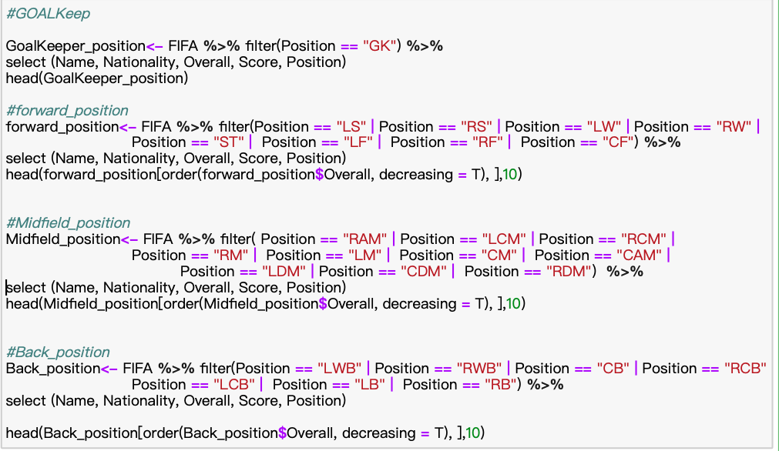
4-3-3 formation

Slide 25
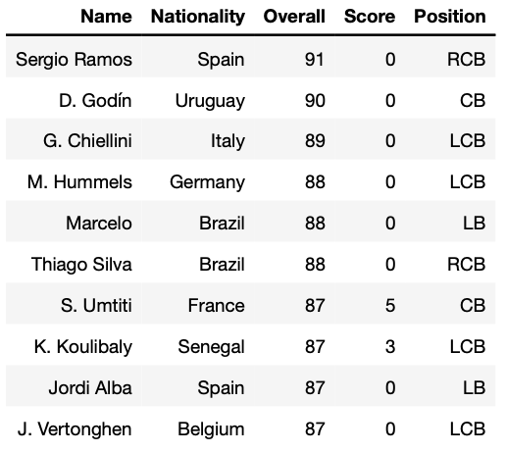
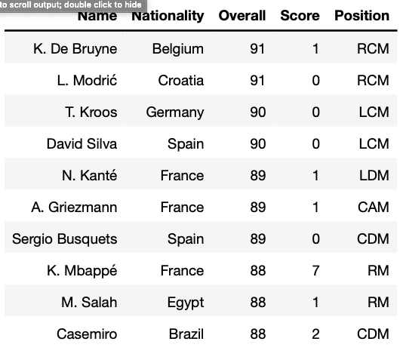
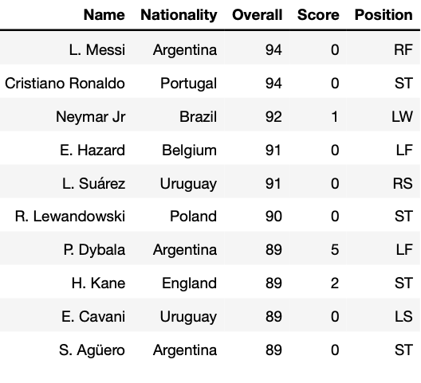
4-3-3 formation

Slide 26
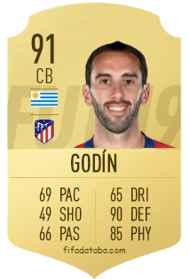
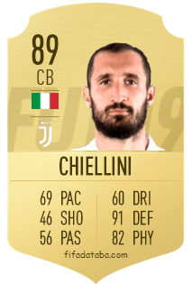
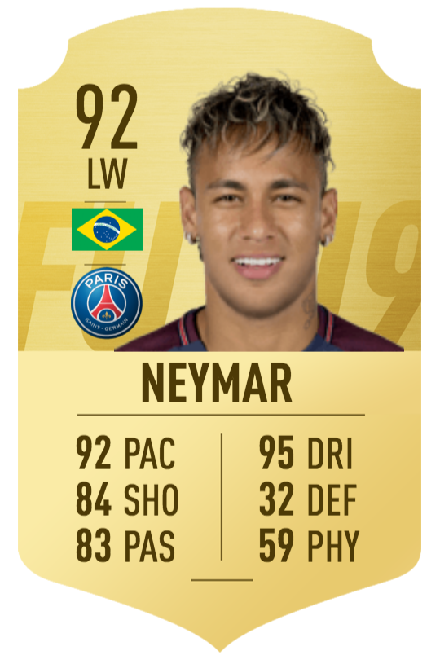
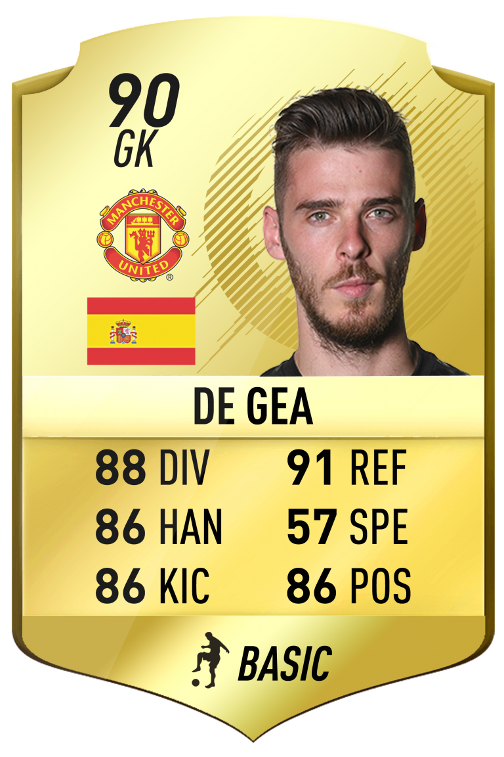
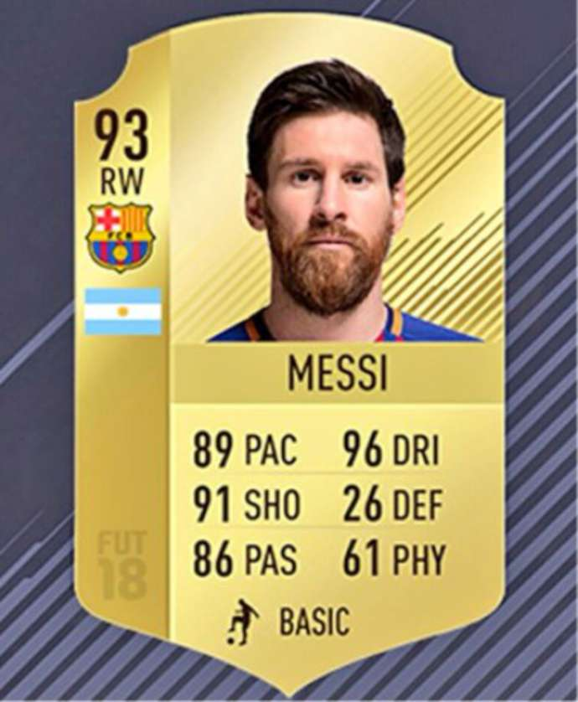
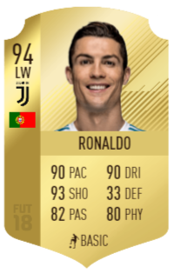
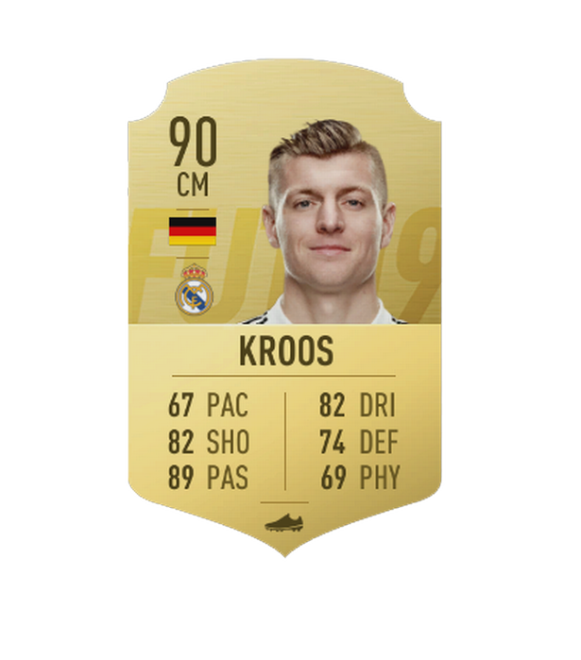
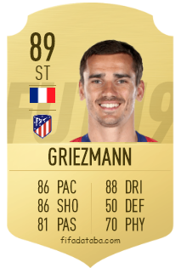
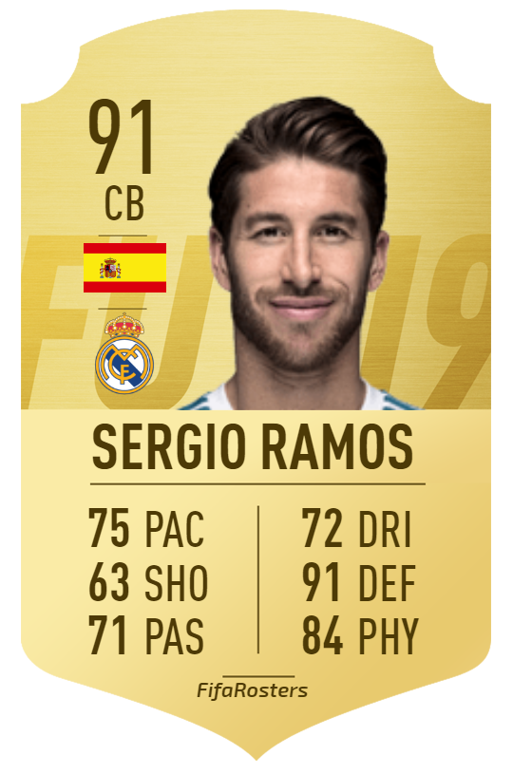
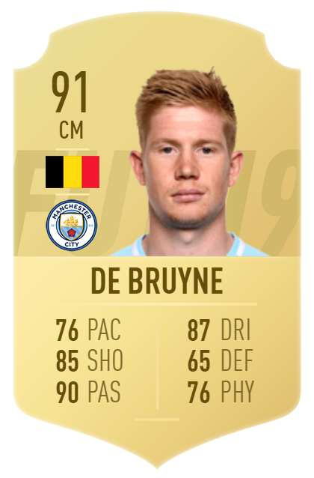
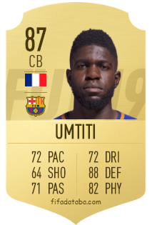
Best Squared

Slide 27
Champions prediction

Slide 28
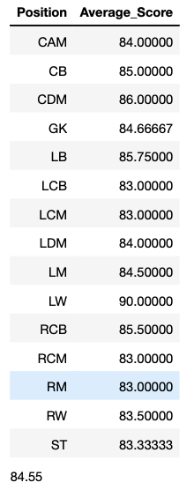
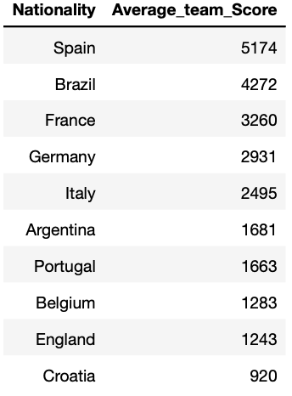
Champions prediction

Slide 29
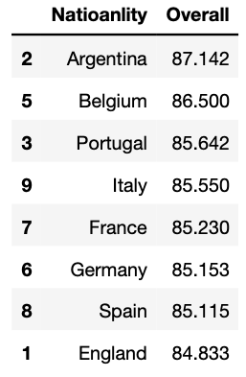

Champions prediction

